Slide 1
Enhance Image Denoising deep neural network by Unsharp Masking
sanathan narayanan – 17bce1094

Slide 2
Introduction:
This project aims to denoise image using the deep neural network concepts with an enhancement in the existing system.
This would be very useful especially in medical applications, where the captured image may get affected by noise.
Denoising an image should result in minimal loss of quality of the image
Noise occurs usually because of cheap sensors, moving sensors, moving objects, low lighting, etc

Slide 3
Introduction cont.:
Nowadays, videos and images have become integral parts of life. Usage of images can range from casual capturing of moments to serious military and biomedical fields.
So, this leads to an increasing demand visually pleasing and accurate pictures.
But we can see that almost all pictures captured by cameras would be corrupted by noise.
Even though the advances in hardware like optics, etc have reduced noises, software denoising is still a popular study
So, this project would aim to denoise images to provide greater clarity than the existing methods.

Slide 4
Domain knowledge:
High Performance Computing (Computing on Large Datasets)
Image Processing – Segmentation
Image Processing – Denoising Image

Slide 5
Literature Survey:
TITLE | AUTHOR | JOURNAL | MERITS | DEMERITS
Quadtree Structured Image Approximation for Denoising and Interpolation | Adam Scholefield, Member, IEEE, and Pier Luigi Dragotti, Senior Member, IEEE | IEEE TRANSACTIONS ON IMAGE PROCESSING, VOL. 23, NO. 3, MARCH 2014 | Close to state-of-the-art Methods in denoising images with simpler algorithm | Natural images have many complex structures, such as texture, which are not well approximated in this model
Adaptive Image Denoising by Targeted Databases | Enming Luo, Student Member, IEEE, Stanley H. Chan, Member, IEEE, and Truong Q. Nguyen, Fellow, IEEE | IEEE TRANSACTIONS ON IMAGE PROCESSING, VOL. 24, NO. 7, JULY 2015 | Adaptive image denoising algorithm using targeted databases. | Again, a complex algorithm with complex formulae are used which is difficult to understand
Image denoising with Edge-preserving and segmentation based on Mask NHA | Fumitaka Hosotani, Yuya Inuzuka, Masaya Hasegawa, Shigeki Hirobayashi, Member, IEEE, Tadanobu Misawa | DOI 10.1109/TIP.2015.2494461, IEEE Transactions on Image Processing | Denoising method uses high-resolution analysis, called 2D NHA | Performance of the proposed method is dependent on the parameters in the partial processes
Image Denoising by Exploring External and Internal Correlations | Huanjing Yue, Xiaoyan Sun, Senior Member, IEEE, Jingyu Yang, Member, IEEE, and Feng Wu, Fellow, IEEE | IEEE TRANSACTIONS ON IMAGE PROCESSING, VOL. 24, NO. 6, JUNE 2015 | A graph-cut based patch matching strategy is utilized to improve patch matching accuracy | Multispectral images are not fully supported

Slide 6
Literature Survey:
TITLE | AUTHOR | JOURNAL | MERITS | DEMERITS
Local SparseStructureDenoising for Low-light-level Image | Jing Han, Jiang Yue, Yi Zhang, Lianfa Bai* | 10.1109/TIP.2015.2447735, IEEE Transactions on Image Processing | Simultaneously preserve both sparsity of patches and local structure in images | Does not support nonlinear structure constraint
Denoising for Low-Dose CT Image by Discriminative Weighted Nuclear Norm Minimization | LINA JIA, QUAN ZHAN, YU SHANG, YANLING WANG, YI LIU1, NA WANG, ZHIGUO GUI, AND GUANRU YANG | Received June 4, 2018, accepted July 26, 2018, IEEE Access | Local entropy-based discrimination and weights adjustment, block matching with preprocessed image, as well as TV-based post processing | The local entropy distribution is obtained through three steps. First, the local entropy is calculated for each pixel. Then, these values are aligned in ascending order. Finally, the entropy distribution curve is depicted, all these cost time
Patch-Based Near-Optimal Image Denoising | Priyam Chatterjee, Student Member, IEEE, and Peyman Milanfar, Fellow, IEEE | IEEE TRANSACTIONS ON IMAGE PROCESSING, VOL. 21, NO. 4, APRIL 2012 | Locally optimal Wiener-filter-based method and have extended it to take advantage of patch redundancy to improve the denoising performance | Developed only for gray scale images
Low Dose CT Image Denoising Using a Generative Adversarial Network with Wasserstein Distance and Perceptual Loss | Qingsong Yang, Pingkun Yan*, Senior Member, IEEE, Yanbo Zhang, Member, IEEE, Hengyong Yu, Senior Member, IEEE | IEEE TRANSACTIONS ON IMAGE PROCESSING, VOL. 24, NO. 6, JUNE 2015 | Has additional Loss Functions to reduce lose of quality after denoising | The loss functions take additional overhead

Slide 7
Literature Survey:
TITLE | AUTHOR | JOURNAL | MERITS | DEMERITS
Dictionary Pair Learning on Grassmann Manifolds for Image Denoising | Xianhua Zeng, Wei Bian, Wei Liu, Jialie Shen, Dacheng Tao, Fellow, IEEE* | 10.1109/TIP.2015.2447735, IEEE Transactions on Image Processing | (TTSP algorithm) Top-bottom Two-dimensional Subspace Partition is an advanced and efficient method | Algorithm is difficult to understand and improve by others
Beyond a Gaussian Denoiser: Residual Learning of Deep CNN for Image Denoising | Kai Zhang, Wangmeng Zuo, Senior Member, IEEE, Yunjin Chen, Deyu Meng, Member, IEEE, and Lei Zhang Senior Member, IEEE | 2017.2662206, IEEE Transactions on Image Processing | The batch Normalization and residual learning are integrated to speed up the training process as well as boost the denoising performance | Is not good at denoising really complex noise

Slide 8
Literature Survey:
TITLE | AUTHOR | JOURNAL | MERITS | DEMERITS
Statistical Nearest Neighbors for Image Denoising | Iuri Frosio, Jan Kautz | IEEE TRANSACTION ON IMAGE PROCESSING, VOL. XX, NO. XX, AUGUST 2017 | The proposed method avoids the drawback of ‘bias the estimate of noise-free patches’ in the traditional method, leading to better quality in coloured noise | Further improving techniques like adaptive modification of offset & effect in enlarged search windows is not discussed
Denoising of Image : A Wavelet Based Approach | RajibGuhathakurta | IEEE 2017 8th Annual Industrial Automation and Electromechanical Engineering Conference (IEMECON) | The proposed SURE Shrink method gives better PSNR when is decomposed with the wavelet packet at lower noise intensities | When the noise intensity is higher, traditional methods give better PSNR values
Global Image Denoising | Hossein Talebi, Peyman Milanfar | IEEE TRANSACTIONS ON IMAGE PROCESSING, VOL. 23, NO. 2, FEBRUARY 2014 | Using Nystrom Etension, the proposed method has reduced the time complexity from O(n^2) to O(n) while computing using ‘global filter’ | Further, methods using asymptotic performance, degrees of freedom could be added to improve performance
An Improved Median Filter Algorithm Based on VC in Image Denoising | Shulei Wu1, Xiangxiang Xu1, Haixia Long1 | IEEE 2014 Tenth International Conference on Computational Intelligence and Security | Improved performance and has good effect in saving detail. Using improved median filtering algorithms | This method makes it hard to cfind the noise points

Slide 9
Literature Survey:
TITLE | AUTHOR | JOURNAL | MERITS | DEMERITS
Evaluation of Image Denoising Techniques A Performance Perspective | Arvind Kumar G, Dr. Ashok Kusagur | IEEE International conference on Signal Processing, Communication, Power and Embedded System (SCOPES)-2016 | The proposed wavelet transform method (basis pursuit) performs well when compared to other median based filter methods | Sparse Representation, which is an advanced basis pursuit algorithm has not been discussed here
An Improved Image Denoising Algorithm | Liqiang Shi | IEEE 2015 Seventh International Conference on Measuring Technology and Mechatronics Automation | This method uses complementing methods of improved threshold denoising & traditional threshold denoising methods, which improves performance greatly. | The algorithm is complex to understand and hence difficult to extend.
A Novel CNN Based Image Denoising Model | Angela Slavova, Victoria Rashkova | IEEE 2011 20th European Conference on Circuit Theory and Design (ECCTD) | This method uses Convection-diffusion, Robust CNN, Harmonic Balance methods to test the problems with known solutions and to verify the obtained results | Applying all these methods and testing will be a time consuming process.
A Decomposition Framework for Image Denoising Algorithms | Gabriela Ghimpe¸teanu, Thomas Batard, Marcelo Bertalmío, and Stacey Levine | IEEE TRANSACTIONS ON IMAGE PROCESSING, VOL. 25, NO. 1, JANUARY 2016 | This method takes into account of the local geometry of the image thereby preserving the moving frame describing the scaled version of image. | This method does not work well if noise model is unknown, i.e., under realistic conditions

Slide 10
Literature Survey:
TITLE | AUTHOR | JOURNAL | MERITS | DEMERITS
Dilated Deep Residual Network for Image Denoising | Tianyang Wang, Mingxuan Sun, Kaoning Hu | IEEE 2017 International Conference on Tools with Artificial Intelligence | Here, they use ‘dilated residual CNN’ method which is more effective in de-noising workload, than simply stacking multiple layers | This method is complex to understand and hence is difficult to expand
Progressive Image Denoising Through Hybrid Graph Laplacian Regularization: A Unified Framework | Xianming Liu, Deming Zhai, Debin Zhao | IEEE TRANSACTIONS ON IMAGE PROCESSING, VOL. 23, NO. 4, APRIL 2014 | This method well utilizes the input space by mapping HD feature space with dictionaries. This method outperforms state-of-the-art methods. | Usage of dictionaries leads to more time consumption, even though the result is very good.

Slide 11
PROBLEM DEFINITION:
The method DNN is not enough for realistic noises, as it cannot recognize noises which are blurred, so usage of ‘Unsharp Masking’ as pre-processing will be demonstrated

Slide 12
Objective:
This project aims to get better denoised image when compared to using DNN, by including a pre-processing using ‘Unsharp Masking’.

Slide 13
EXISTING SYSTEM:
There are many methods such as BM3D, WNNM, EPLL, MLP, CSF, TNRD, etc
But these methods do not provide acceptable images especially for serious medical usage.

Slide 14
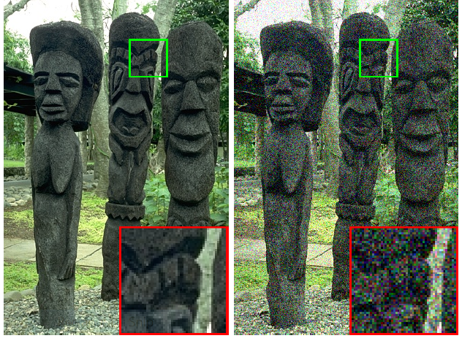
Existing system:
As we can see, the denoised image can be still improved
The state-of-art methods like CDnCNN are highly efficient,
but they have to implemented by a good GPU especially for
large number of images.
The existing system (MSt-SVD, CMSt-SVD deal with grouping,
collaborative filtering, etc. but with not enough pre-processing
of the image like softening, etc
Denoised by CDnCNN method

Slide 15
PROPOSED SYSTEM:
This project aims to bring about improvement in the existing system by pre-processing the images (like sharpening) before hand to remove the noise more efficiently.
Here the pre-processing would be done only up to the requirement as more of it can cause loss in clarity of the image.
After the pre-processing of the image, it will be sent to the Deep Neural Network module, which would denoise it to produce image with acceptable quality even for medical standards.
Pre-processing is especially done so that the image de-noise algorithm can easily remove the noise from the image without causing additional noises, etc.

Slide 16




ARCHITECTURE DIAGRAM:
Noise Less Image
DNN-Code
Noise
Noisy Image
Usage
Noiseless Image
Unsharp Filter

Slide 17
Modules & Module Description:
M1:
Obtaining the Noisy Image:
Use Noisy Image = Noise less Image + Noise (using say Gaussian Noise)
M2:
Pre-processing the Noisy Image (like Sharpening using Unsharp Masking)
M3:
Apply Deep neural Network (DNN) to obtain Noiseless Image from Pre-processed Image
M4:
Testing & Usage of De-Noised Image

Slide 18
Algorithm General approach:
Start
Read the Noisy Image
We can also get Noisy Image by Oringinal Image + Noise
Pre-process the Noisy Image
Use UnSharp Masking to Sharpen Image
Do further Pre-processing as required
Apply DNN to De-Noise the pre-processed Image
Obtain the Noiseless Image
Usage of the Noiseless Image
Stop

Slide 19
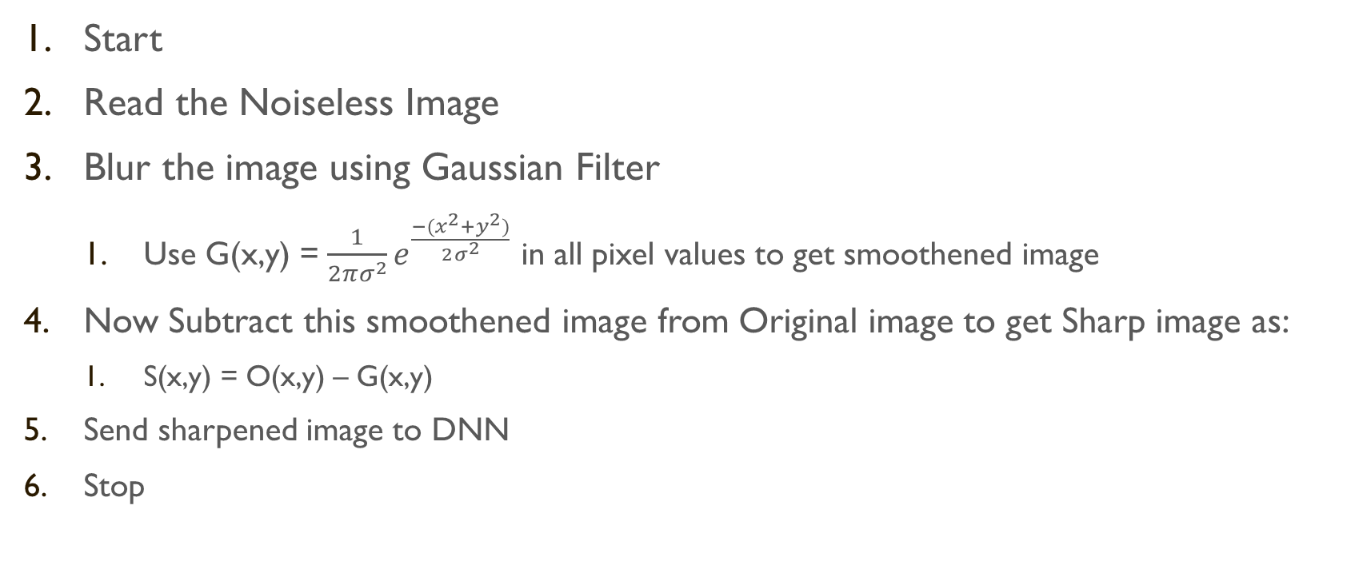
Algorithm for unsharp masking:
Start
Read the Noiseless Image
Blur the image using Gaussian Filter
Use G(x,y) = $\frac{1}{2πσ^{2}}e^{\frac{−{(x}^{2}{+y}^{2})}{2σ^{2}}}$ in all pixel values to get smoothened image
Now Subtract this smoothened image from Original image to get Sharp image as:
S(x,y) = O(x,y) – G(x,y)
Send sharpened image to DNN
Stop

Slide 20
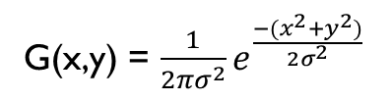
Diagram for unsharp masking:
Noisy Image
G(x,y) = $\frac{1}{2πσ^{2}}e^{\frac{−{(x}^{2}{+y}^{2})}{2σ^{2}}}$
Smoothened Noisy Image
-
+
+
Sharpened Image

Slide 21
Tools Used:
MATLAB r2017b
MATLAB Deep Learning Toolbox™
Image Dataset

Slide 22
Implementation Results:
After applying the unsharp masking, the efficiency of DNN in noise removal has increased.
We can also check this by blurring the noisy image and then applying DNN, this decreased the efficiency of DNN.
Original Image:

Slide 23
Implementation Results: Noisy Image

Slide 24
Implementation Results: Sharpened Noisy Image by unsharp masking

Slide 25
Implementation Results: Denoised Noisy Image

Slide 26
Implementation Results: Denoised Sharpened Noisy Image

Slide 27
Implementation Results: Histogram of Noisy Image

Slide 28
Implementation Results: Histogram of Denoised Blurred Noisy Image

Slide 29
Implementation Results: Histogram of Denoised Noisy Image

Slide 30
Implementation Results: Histogram of Original Image

Slide 31
Implementation Results: Histogram of Denoised Sharpened Noisy Image

Slide 32
Conclusion:
As we can see that, sharpening the noisy image before giving it to DNN enhances the process.
The Image Histogram of pre-processed Denoised Image retains features better than the one without pre-processing.
This would be useful in medical applications where every minute detail needs to be preserved
This would also be useful in satellite geographical analysis, military analysis.

Slide 33
Future Work:
The future work of this project would be to increase the speed of the execution, as pre-processing would consume more time.
Consumption of time will increase drastically for bulk images.
Also, even more enhancement can be researched and achieved.

Slide 34
REFERENCES:
[1] Denoising for Low-Dose CT Image by Discriminative Weighted Nuclear Norm Minimization
[2] Beyond a Gaussian Denoiser: Residual Learning of Deep CNN for Image Denoising
[3] Local SparseStructureDenoising for Low-light-level Image
[4] Patch-Based Near-Optimal Image Denoising
[5] Dictionary Pair Learning on Grassmann Manifolds for Image Denoising

Slide 35
THANK YOU!

